Slide 1
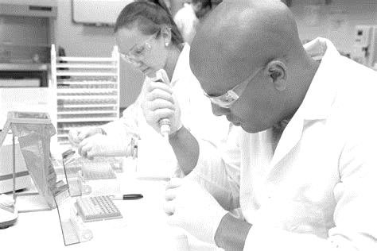
Research Restart
Keeping everyone safe, while increasing research activity in a phased approach as safety becomes easier to maintain.

Slide 2
Learning Goals
Restart Principles
COVID-19 Overview
Minimizing Risks
Disinfecting
Use of PPE

Slide 3
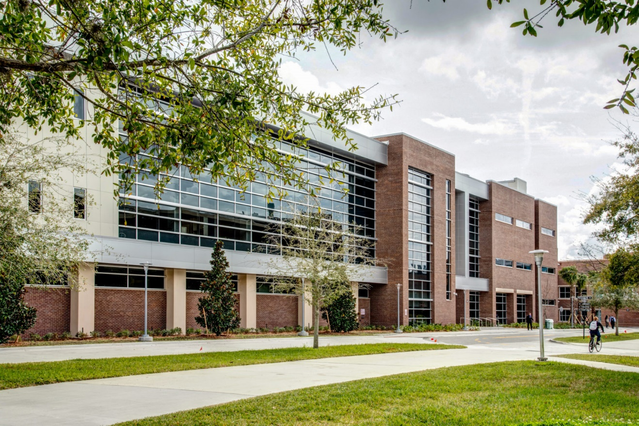
Principles for Research Restart
The university has adopted a set of principles to guide researchers in restarting scientific activities:

Slide 4
Principles for Research Restart
Follow the cognizant Local, State, and National Public Health Authority directives to shelter-at-home and implement social distancing.
Protect the health and safety of the research workforce, emotional as well as physical. Protect the health and safety of our clinical patients and human research subjects.
Undergraduates are students first, researchers second.
Implement a fair and transparent process for granting access.
Ensure as rapid a research restart as the public health conditions permit.
Participate in finding cures and preventions for COVID-19, and in assessing the economic, political, and cultural impacts of the virus, while increasing the safe access to all patients to clinical trials for their conditions.

Slide 5
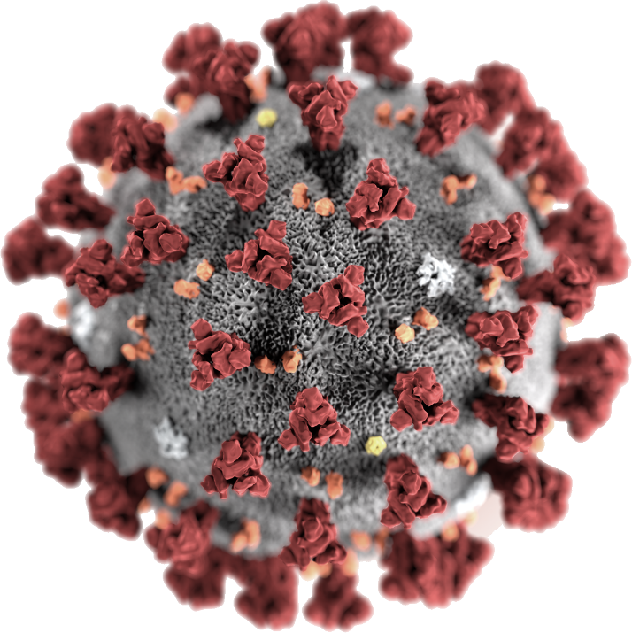
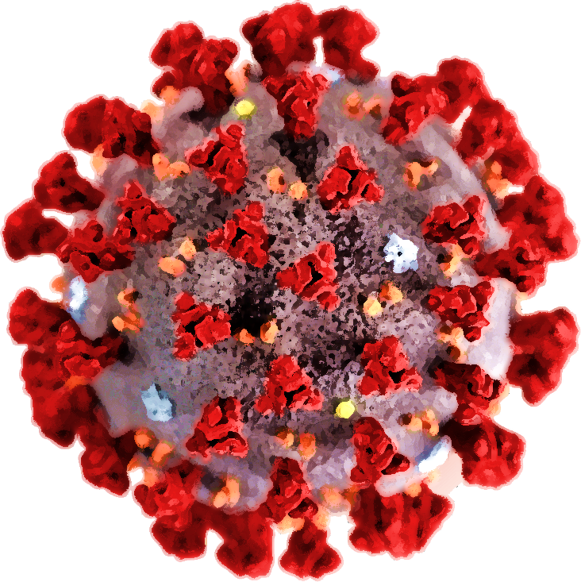
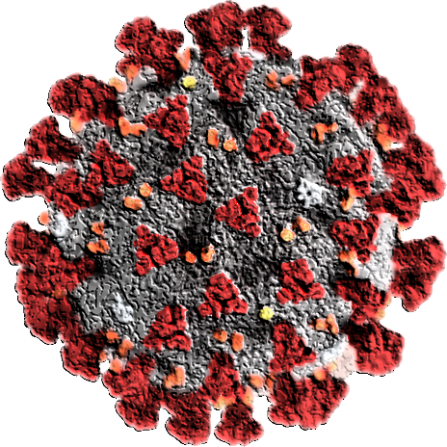
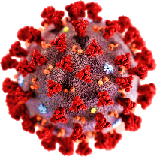
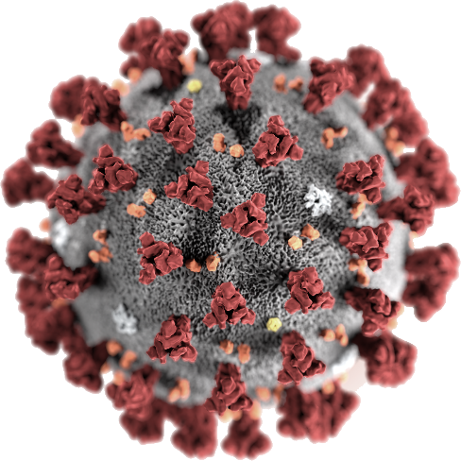
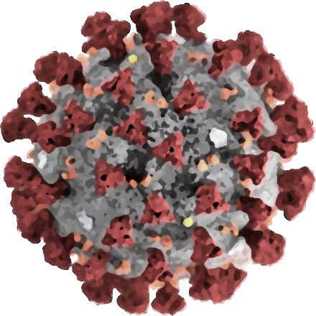
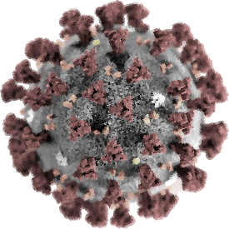
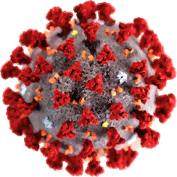
COVID-19 Overview

Slide 6
COVID-19
Routes of Transmission:
According to CDC, the novel coronavirus (COVID-19) can be spread from person-to-person.
Most frequently occurs when in close contact (< 6 feet) with infected individual(s).
Transmission occurs via respiratory droplets (from coughs or sneezes).
Asymptomatic individuals can spread the disease
Transmission of COVID-19 via contaminated surfaces, is not currently well documented.
Evidence suggests COVID-19 may remain viable for hours/days on surfaces made from a variety of materials.
Cleaning and disinfecting of visibly dirty surfaces is a best practice for prevention of COVID-19 and any other viral respiratory illness.

Slide 7
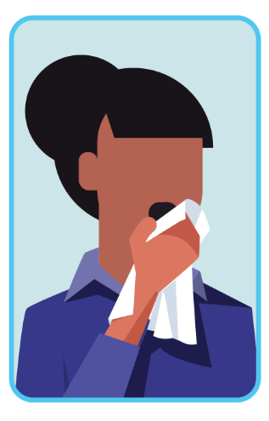
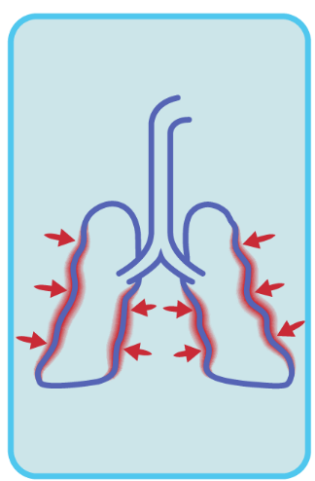
COVID-19
Note: any illness in the workplace puts others at risk, please stay home if you are sick
Symptoms
People with these symptoms or combinations of symptoms may have COVID-19:
Cough
Shortness of breath or difficulty breathing
Or at least two (2) of these symptoms:
Fever
Chills
Muscle pain
Repeated shaking with chills
Headache
Sore throat
New loss of taste or smell

Slide 8
COVID-19
High Risk Individuals
Certain medical conditions increase risk for developing serious COVID-19 illness:
Persons over 65 years of age
Persons with chronic lung disease or moderate to severe asthma
Persons with diabetes
Persons with serious heart conditions
Immunocompromised individuals (cancer treatment, bone marrow/organ recipients, those with chronic immunodeficiencies, poorly controlled HIV or AIDS, prolonged use of corticosteroids and other immune weakening medications)
Persons with severe obesity (body mass index of 40 or higher)
Persons with liver disease
Persons with chronic kidney disease undergoing dialysis
If you have one of these conditions, please consult with your healthcare provider concerning the particular risk associated with your return to work at this time.

Slide 9
Steps for Infection Control
Social Distancing
Come to campus only if absolutely necessary
Hold meetings (even one-on-one sessions) over the phone or virtually
Stay 6 feet away from others
No more than 10 people in a room at one time
Take into account all individuals must maintain the 6 foot separation
If 6 foot separation cannot be maintained in a space with 10 people, maximum number for the space will be reduced allowing 6 foot separation
Do not come to campus if you are not feeling well (i.e., fever, cough, breathing difficulty, or other cold or flu-like symptoms)
Contact your supervisor detailing why you are not reporting to work

Slide 10
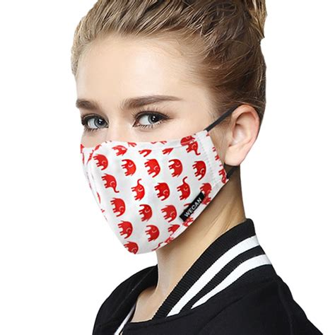
Steps for Infection Control
Cloth Face Coverings
Not intended to protect the wearer, but may prevent the spread of virus from the wearer to other
Always inspect for any damage prior to use
Wash hands before putting your on face covering
Avoid touching your face when removing the covering
Avoid touching the fabric part of the face covering
Treat outside of used covering as contaminated
Wash hands after removal

Slide 11
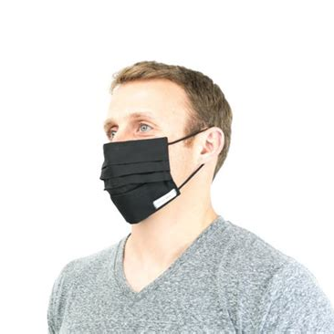
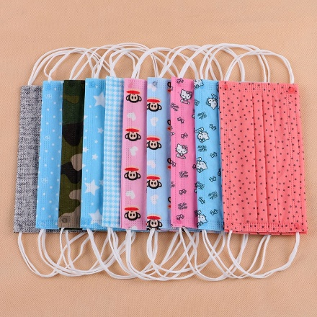
Steps for Infection Control
Cloth Face Coverings
Use ear loops or ties to secure and remove mask
Pull the ties and loops so that it fits as snugly as possible against your face
Should cover mouth and nose
Wash daily, either in the washing machine or by hand
Wash with laundry detergent and hottest water possible
Dry on a hot cycle or air dry
Inspect for damage

Slide 12
Donning & Doffing Face Coverings

Slide 13
Steps for Infection Control
Personal Hygiene
Cough/sneeze into a tissue
Immediately dispose of used tissues into a trashcan
Wash hands
If no tissues available, cough/sneeze into the crook of your elbow, not your hands
Avoid touching face, eyes, nose, and mouth
Wear personal protective equipment, as appropriate in the laboratory
UCF minimum: safety glasses, closed toe shoes, and long pants

Slide 14
Steps for Infection Control
Proper use of hand sanitizer
Personal Hygiene
Wash hands frequently
Minimally when entering and exiting laboratory
After touching your face
Use soap and water when available (Use alcohol-based hand sanitizer if no soap + water)
Apply Product to palm of hand
Rub hands together
Proper hand washing
Lather & scrub (20 seconds)
Wet Hands
Get soap
Rinse
Dry hands
Cover all surfaces & scrub
(20 seconds)

Slide 15
Hand Washing

Slide 16
Disinfecting
Maintain routine disinfecting processes in labs
Cleaning and disinfection should occur upon entering the laboratory, during work, and after work completion
Pay special attention to high-touch areas
These areas have higher probability of viral loading in the work area and should be disinfected on a routine basis and immediately after use
Light switches
Door handles
Benchtops
Equipment handles and latches
Equipment controls and touchpads
Drawer and cabinet handles
Bin and water incubator lids
Hand tools, Micro-pipettors
Faucet handles and sprayer grips
Chemical bottles and lids
Chair backs and arm rests
Pens, whiteboard markers
Shared computer mice and keyboards

Slide 17
Disinfecting
Maintain routine disinfecting processes in labs
Maintain a list of high-touch locations and equipment
Clean and disinfect identified locations on a routine basis
Use an EPA-approved disinfectant that is effective against COVID-19
The list of EPA-approved disinfectants can be found at the following link: https://www.epa.gov/pesticide-registration/list-n-disinfectants-use-against-sars-cov-2
Do not assume that a disinfectant works on contact (Pay attention to disinfectant contact times)
Wear appropriate PPE when using cleaning/disinfectant products.
Reference the Safety Data Sheet (SDS) for further information on PPE
Contact Environmental Health and Safety (EHS) with questions
Use care with delicate equipment to avoid damage; cleaning sprays may not be appropriate to use or could damage equipment

Slide 18
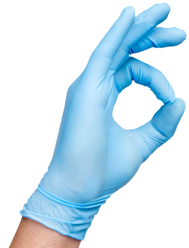
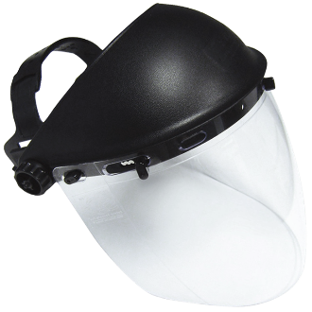
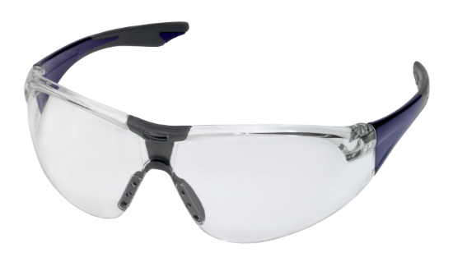
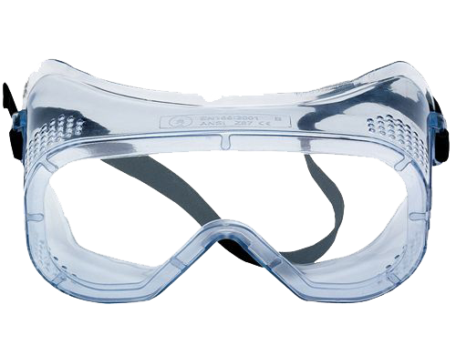
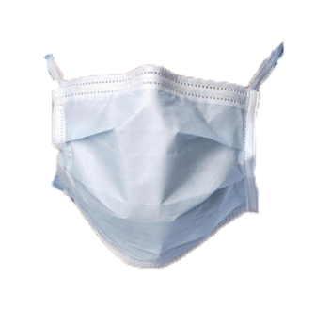
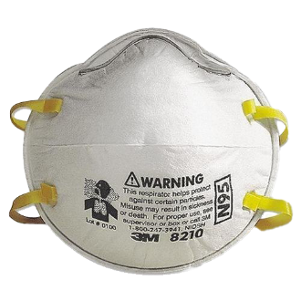
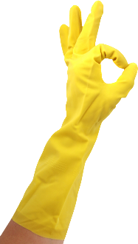
Personal Protective Equipment (PPE)
All individuals must be trained in proper use of PPE for general and specific laboratory tasks
Examples of PPE:
Gloves
Face Shields
Lab coats
Safety glasses
Face masks (surgical masks, and procedural masks)
Respirators (N95)

Slide 19
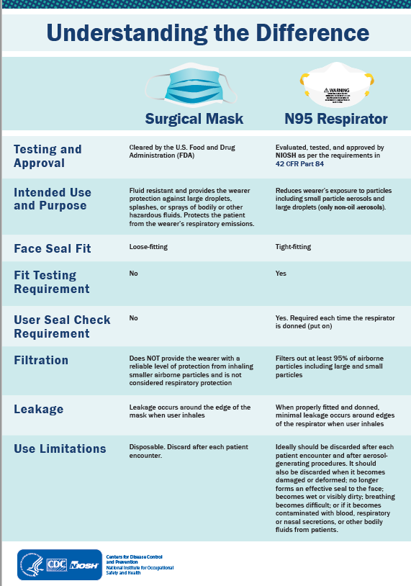
Respirators vs. Surgical Masks

Slide 20
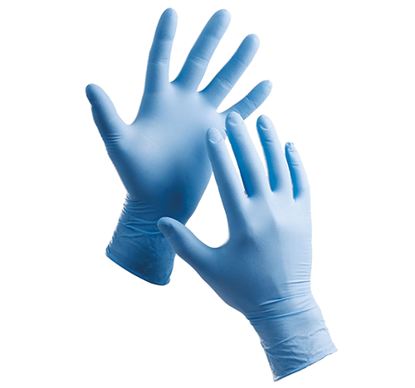
PPE
Disposable gloves
Wash your hands before and after you use gloves
Always replace gloves when beginning a new task
Never use the same pair of gloves for different tasks, especially if you’re dealing with potential contaminants
Change damaged gloves immediately
Regularly check your gloves for potential damage

Slide 21
Donning and Doffing Gloves

Slide 22
Useful Links
Proper hand-washing
https://www.cdc.gov/handwashing/when-how-handwashing.html
Hand Sanitizer use
https://www.cdc.gov/handwashing/show-me-the-science-hand-sanitizer.html
Glove use/changing
https://www.yourglovesource.com/blogs/glove-knowledgebase/how-often-should-you-change-your-disposable-gloves
EPA-approved disinfectants
https://www.epa.gov/pesticide-registration/list-n-disinfectants-use-against-sars-cov-2
Respirators vs. Masks
https://www.fda.gov/medical-devices/personal-protective-equipment-infection-control/n95-respirators-and-surgical-masks-face-masks

Slide 24
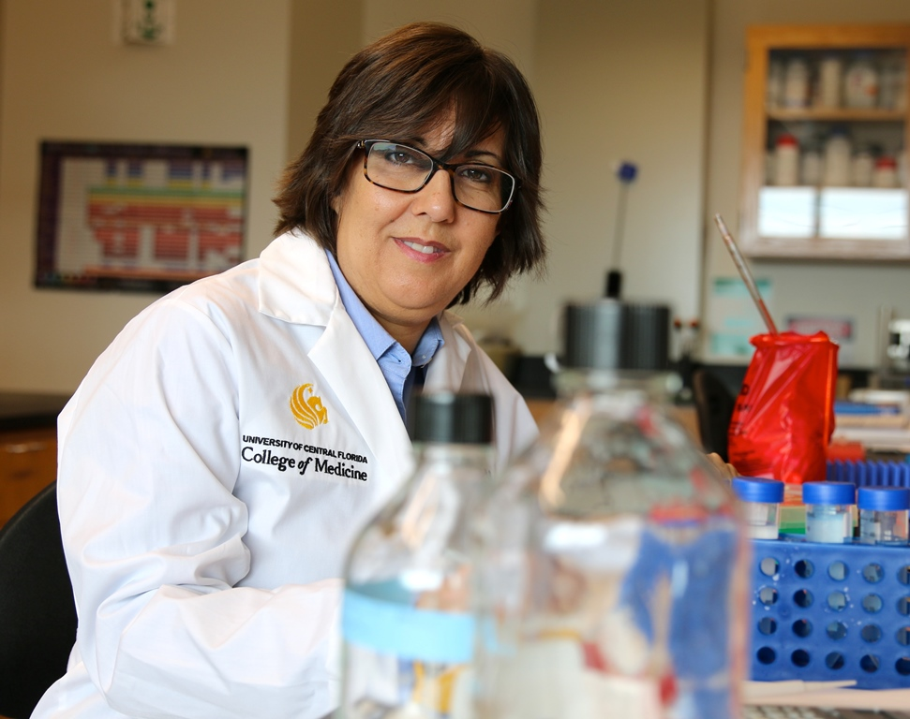
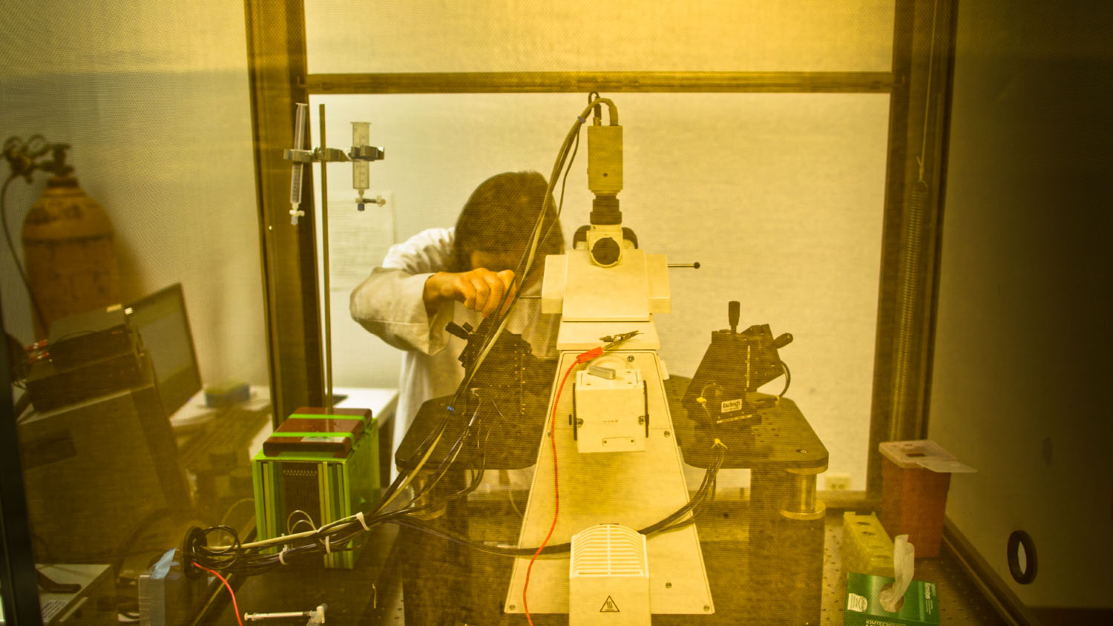
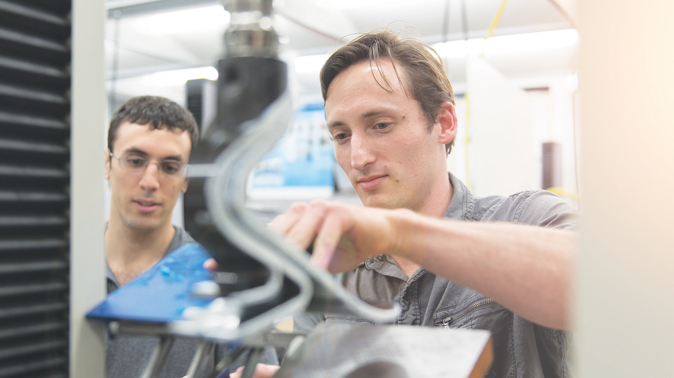
Stock photos

